Slide 1
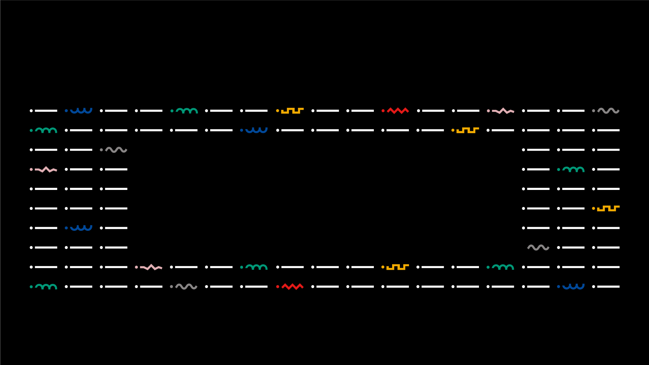

DEGREE IN COMPUTER ENGINEERING
ARTIFICIAL INTELLIGENCE
~ PW1-Solving problems by search or PathFinding; ~
29043 – muhammetsezgin@ipvc.pt
muhammetsezgin@ipvc.pt
Jorge Ribeiro
jribeiro@estg.ipvc.pt
Degree of Computer Science | Escola Superior de Tecnologia e Gestão| Curricular Unit Artificial Intelligence| Academic Year 2021/2022

Slide 2

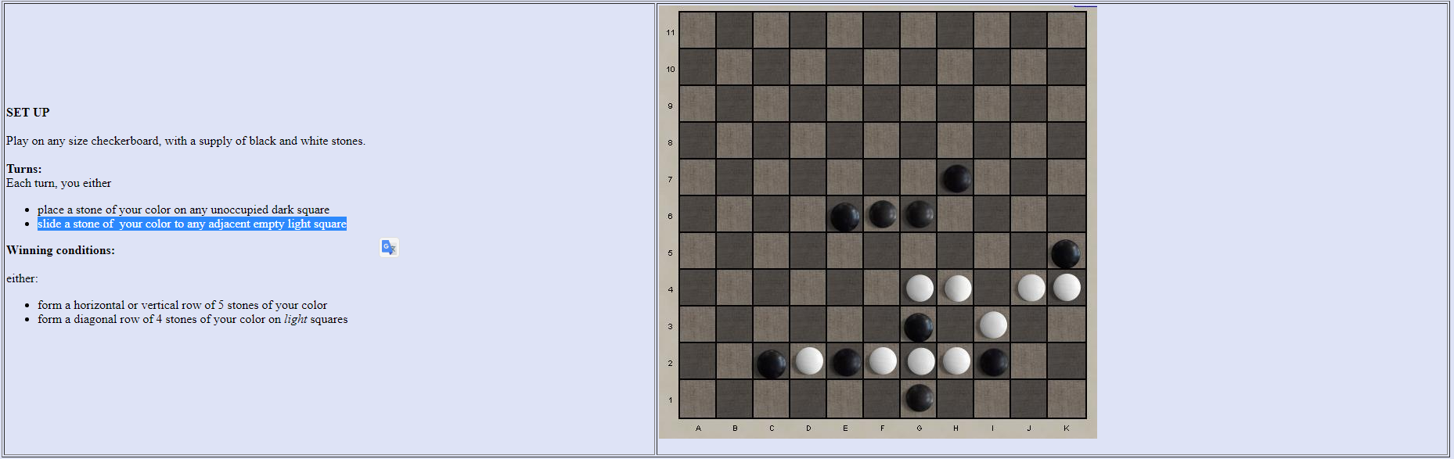

■ PW1-Solving problems by search or PathFinding
■ DAY OR NIGHT GAME
Degree in Computer Engineering
RULES
The game is played on a black and white board. Only black squares can be added, and only white squares can be moved.
@2022, 29043 – muhammetsezgin@ipvc.pt | Curricular Unit: ARTIFICIAL INTELLIGENCE - Academic Year 2021/2022
- 2 -

Slide 3
■ PW1-Solving problems by search or PathFinding
■ Introduction
Degree in Computer Engineering
Day Or Night game is a pretty simple game. Players can learn the game rules and start playing within minutes.
The game, which becomes more complicated as the duration of the game increases, can be played on boards of any size.
While writing the game, I totally depended on github codes.
The minimax algorithm is used for the game.
Game rules and winning conditions have been applied.
The game can be played as human-human, human-random, random-random and minimax-human.
All game codes are written by me.
Changes in the code are explained below
@2022, 29043 – muhammetsezgin@ipvc.pt | Curricular Unit: ARTIFICIAL INTELLIGENCE - Academic Year 2021/2022
- 3 -

Slide 4
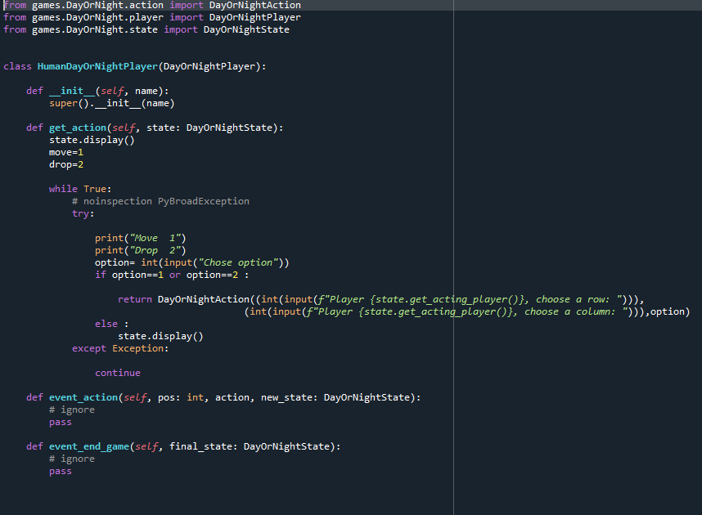
■ PW1-Solving problems by search or PathFinding
■ Human Class
Degree in Computer Engineering
Human class has 3 variable. These are row,col and players move(drop or move). Changes will occur in the state class
@2022, 29043 – muhammetsezgin@ipvc.pt | Curricular Unit: ARTIFICIAL INTELLIGENCE - Academic Year 2021/2022
- 4 -

Slide 5
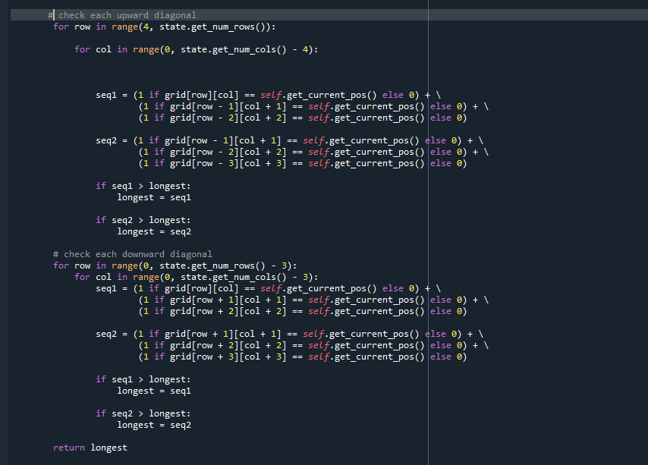
■ PW1-Solving problems by search or PathFinding
■ Minimax Class
Degree in Computer Engineering
Minimax algorithm has been updated according to the rules of the game
@2022, 29043 – muhammetsezgin@ipvc.pt | Curricular Unit: ARTIFICIAL INTELLIGENCE - Academic Year 2021/2022
- 5 -

Slide 6
■ PW1-Solving problems by search or PathFinding
■ Minimax Explanation
Degree in Computer Engineering
The minimax algorithm is basically an algorithm that evaluates the odds where the opposing player's scores are the lowest and their own scores are the highest. This algorithm, which is realized with the regenerative function algorithm, always acts by thinking that the opposite player will make the best move.
In the Human-Computer game, the computer calculates the highest score for itself, thanks to the heuristic function, after the human player's move and displays a move in this direction.
@2022, 29043 – muhammetsezgin@ipvc.pt | Curricular Unit: ARTIFICIAL INTELLIGENCE - Academic Year 2021/2022
- 6 -

Slide 7
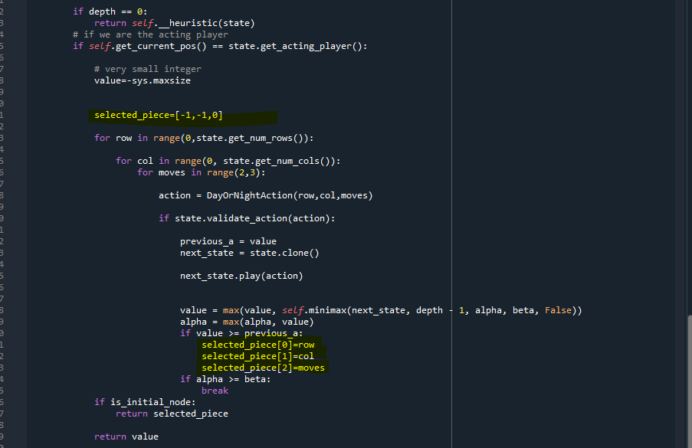
■ PW1-Solving problems by search or PathFinding
■ Minimax Explanation
Degree in Computer Engineering
@2022, 29043 – muhammetsezgin@ipvc.pt | Curricular Unit: ARTIFICIAL INTELLIGENCE - Academic Year 2021/2022
- 7 -

Slide 8
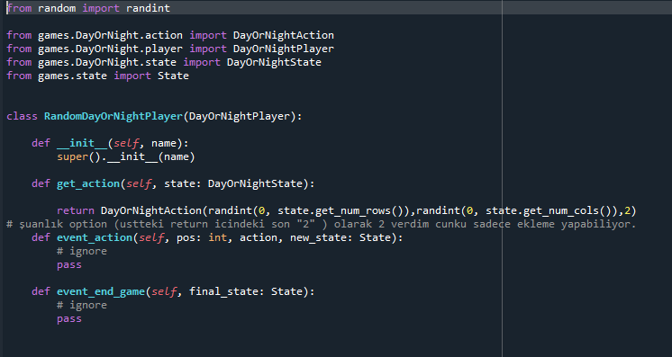
■ PW1-Solving problems by search or PathFinding
■ Random Class
Degree in Computer Engineering
Random class has also been updated according to the newly added col feature and is in working condition.
@2022, 29043 – muhammetsezgin@ipvc.pt | Curricular Unit: ARTIFICIAL INTELLIGENCE - Academic Year 2021/2022
- 8 -

Slide 9
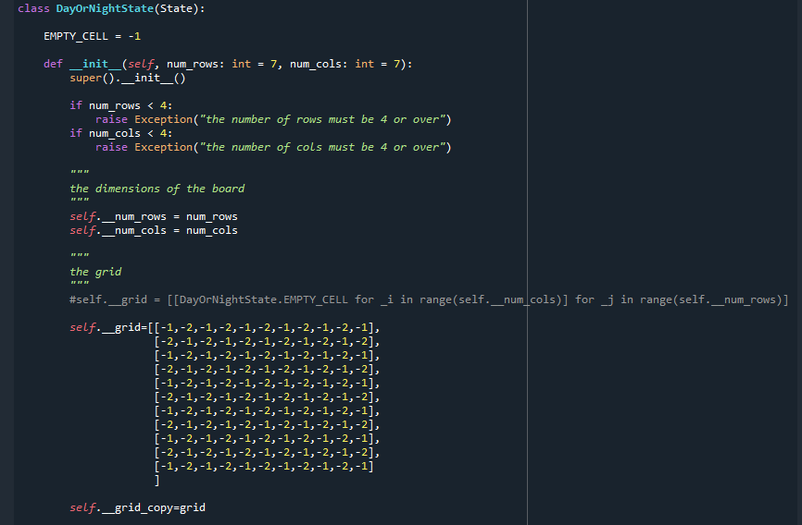
■ PW1-Solving problems by search or PathFinding
■ State
Degree in Computer Engineering
State game rules are determined by the codes. Writing the game rules was the most difficult part. In particular, writing by adhering to github codes sometimes made it harder for me. The required rules have been fulfilled.
@2022, 29043 – muhammetsezgin@ipvc.pt | Curricular Unit: ARTIFICIAL INTELLIGENCE - Academic Year 2021/2022
- 9 -

Slide 10
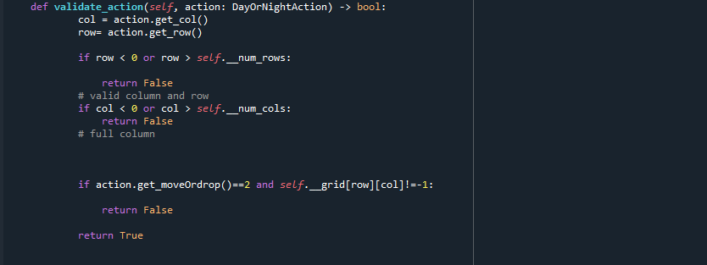
■ PW1-Solving problems by search or PathFinding
■ State
Degree in Computer Engineering
@2022, 29043 – muhammetsezgin@ipvc.pt | Curricular Unit: ARTIFICIAL INTELLIGENCE - Academic Year 2021/2022
- 10 -

Slide 11
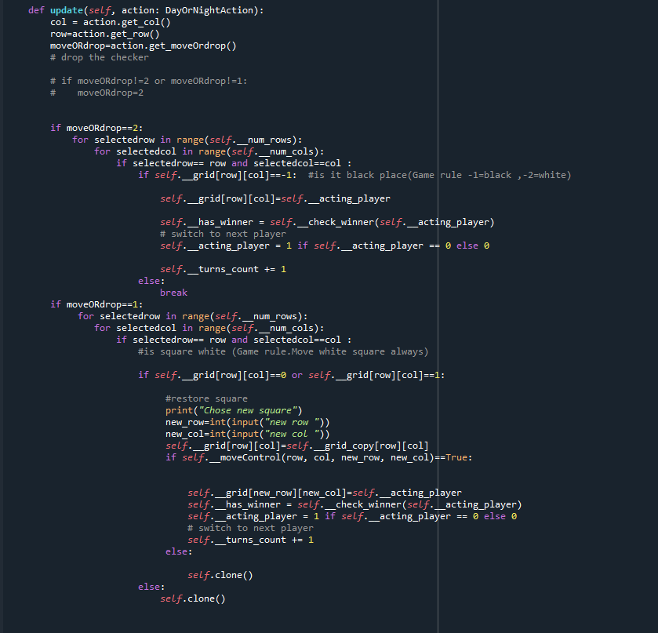
■ PW1-Solving problems by search or PathFinding
■Move and update functions
Degree in Computer Engineering
@2022, 29043 – muhammetsezgin@ipvc.pt | Curricular Unit: ARTIFICIAL INTELLIGENCE - Academic Year 2021/2022
- 11 -

Slide 12
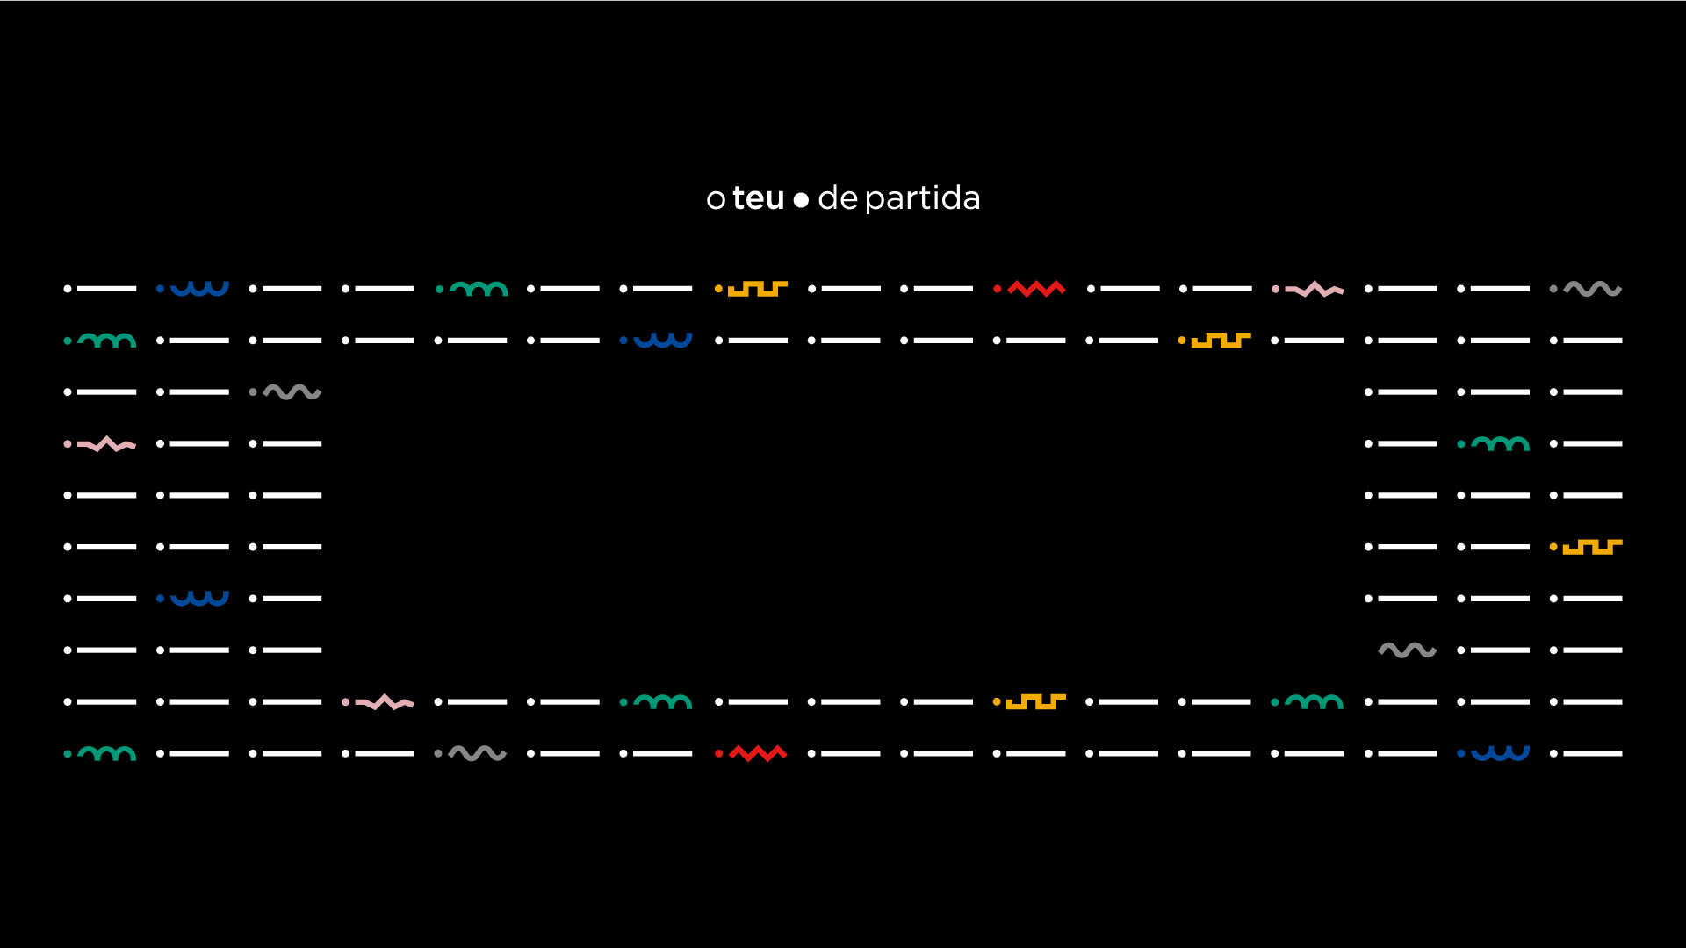
www.ipvc.pt

